Slide 1
Introduction to Decision Trees
Matthew Casey’s AI course

Slide 2
Key Concepts of AI
Machines learning from experience…
  Through examples, analogy or discovery
Adapting…
  Changes in response to interaction
Generalising…
  To use experience to form a response to novel situations

Slide 3
review: What is Learning?
‘The action of receiving instruction or acquiring knowledge’
‘A process which leads to the modification of behaviour or the acquisition of new abilities or responses, and which is additional to natural development by growth or maturation’
Oxford English Dictionary (1989). Learning, vbl. n. 2nd Edition. http://dictionary.oed.com/cgi/entry/50131042?single=1&query_type=word&queryword=learning&first=1&max_to_show=10. [Accessed 16-10-06].

Slide 4
review: Machine Learning
Negnevitsky:
  ‘In general, machine learning involves adaptive mechanisms that enable computers to learn from experience, learn by example and learn by analogy’ (2005:165)
Callan:
  ‘A machine or software tool would not be viewed as intelligent if it could not adapt to changes in its environment’ (2003:225)
Luger:
  ‘Intelligent agents must be able to change through the course of their interactions with the world’ (2002:351)

Slide 5
Types of Learning
Inductive learning
  Learning from examples
  Supervised learning: training examples with a known classification from a teacher (ANN, Decision Tree Learning)
  Unsupervised learning: no pre-classification of training examples (clustering, HMM, dimension reduction: PCA, rough set)
Evolutionary/genetic learning
  Shaping a population of individual solutions through survival of the fittest
  Emergent/sudden behaviour/interaction.

Slide 6
Why need learning?
Knowledge Engineering Bottleneck
  ‘Cost and difficulty of building expert systems using traditional […] techniques’ (Luger 2002:351)
Complexity of task / amount of data
  Other techniques fail or are computationally expensive
Problems that cannot be defined
  Discovery of patterns / data mining

Slide 7
Example: Ice-cream
When should an ice-cream seller attempt to sell ice-cream?
  Could you write a set of rules?
  How would you acquire the knowledge?
You might learn by experience:
  For example, experience of:
  ‘Outlook’: Overcast or Sunny
  ‘Temperature’: Hot, Mild or Cold
  ‘Holiday Season’: Yes or No

Slide 8
Example: Ice-cream (contd...)
Randomly Ordered Data
Outlook | Temperature | Holiday Season | Result
Overcast | Mild | Yes | Don’t Sell
Sunny | Mild | Yes | Sell
Sunny | Hot | No | Sell
Overcast | Hot | No | Don’t Sell
Sunny | Cold | No | Don’t Sell
Overcast | Cold | Yes | Don’t Sell

Slide 9
Generalisation
What should the seller do when:
  ‘Outlook’: Sunny
  ‘Temperature’: Hot
  ‘Holiday Season’: Yes
What about:
  ‘Outlook’: Overcast
  ‘Temperature’: Hot
  ‘Holiday Season’: Yes
Sell
Sell

Slide 10
Can A Machine Learn?
From a limited set of examples, you should be able to generalise
  How did you do this?
  How can we get a machine to do this?
Machine learning is the branch of Artificial Intelligence concerned with building systems that generalise from examples

Slide 11
Decision Trees

Slide 12
Decision Trees
A map of the reasoning process, good at solving classification problems (Negnevitsky, 2005)
A decision tree represents a number of different attributes and values
  Nodes represent attributes
  Branches represent values of the attributes
Path through a tree represents a decision
Tree can be associated with rules

Slide 13
Example 1: Ice-cream
Branch
(value of
attributes)
Outlook
Root node
Node
(attributes)
Sunny
Overcast
Temperature
Holiday Season
Leaf
Hot
Mild
Cold
Yes
No
Sell
Holiday Season
Don’t Sell
Temperature
Don’t Sell
Yes
No
Hot
Mild
Cold
Sell
Don’t Sell
Sell
Don’t Sell
Don’t Sell

Slide 14
Construction
Concept learning:
  Inducing concepts from examples
Different algorithms used to construct a tree based upon the examples
  Most popular ID3 (Quinlan, 1986)
But:
  Different trees can be constructed from the same set of examples
  Real-life is noisy and often contradictory

Slide 15
Ambiguous Trees
Consider the following data:
pewarna
pengawet
Item | X | Y | Class
1 | False | False | +
2 | True | False | +
3 | False | True | -
4 | True | True | -
Pewarna = food coloring
Pengawet = preservatives

Slide 16
Ambiguous Trees
Y
True
False
{3,4}
Negative
{1,2}
Positive

Slide 17
Ambiguous Trees
X
True
False
{2,4}
Y
{1,3}
Y
True
False
True
False
{4}
Negative
{2}
Positive
{3}
Negative
{1}
Positive
Different trees can be constructed from the same set of examples.
Which tree is the best?
Based upon choice of attributes at each node in the tree
A split in the tree (branches) should correspond to the predictor with the maximum separating power

Slide 18
Information Theory
We can use Information Theory to help us understand:
  Which attribute is the best to choose for a particular node of the tree
  This is the node that is the best at separating the required predictions, and hence which leads to the best (or at least a good) tree
‘Information Theory address both the limitations and the possibilities of communication’ (MacKay, 2003:16)
  Measuring information content
  Probability (measure of chance) and entropy (measure of disorder)
MacKay, D.J.C. (2003). Information Theory, Inference, and Learning Algorithms. Cambridge, UK: Cambridge University Press.

Slide 19

Choosing Attributes
Entropy:
  Measure of disorder/unexpected/uncertainty/ surprise/random (high means containing high information)
For c classification categories
Attribute a that has value v
Probability of v being in category i is p_{i}
Entropy E is:

Slide 20
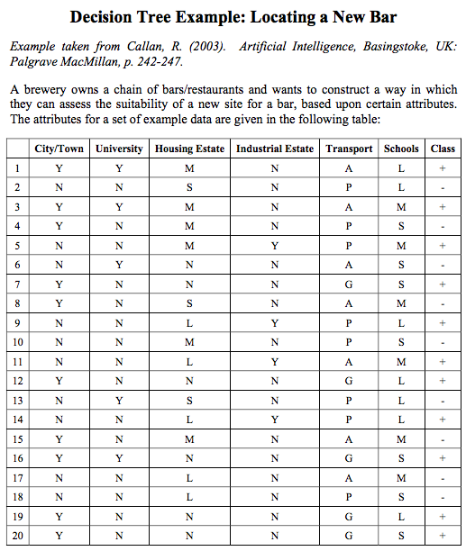
The attributes define whether
the example is a:
City or town: Yes or No
Has a university nearby: Yes or No
Type of nearby housing estate:
None, Small, Medium, Large
Quality of public transport:
Good, Average, Poor
The number of school nearby:
Small, Medium, Large

Slide 21
Entropy Example
Choice of attributes:
  City/Town, University, Housing Estate, Industrial Estate, Transport and Schools
City/Town: is either Y or N
For Y: 7 positive examples, 3 negative
For N: 4 positive examples, 6 negative

Slide 22
For Y:
7 positives, 3 negatives

Slide 23
For N:
4 positives, 6 negatives

Slide 24
Entropy Example
City/Town as root node:
  For c=2 (positive and negative) classification categories
  Attribute a=City/Town that has value v=Y
  Probability of v=Y being in category positive
    p_{i=positive} = 7/10
  Probability of v=Y being in category negative
    p_{i=negative} = 3/10

Slide 25
Entropy Example
City/Town as root node:
  For c=2 (positive and negative) classification categories
  Attribute a=City/Town that has value v=Y
  Entropy E is:
  E(City/Town = Y) = -7/10 x log₂ 7/10 - 3/10 x log₂ 3/10
  = -[0.7 x -0.51 + 0.3 x -1.74 ]
  = 0.881

Slide 26
Entropy Example
City/Town as root node:
  For c=2 (positive and negative) classification categories
  Attribute a=City/Town that has value v=N
  Probability of v=N being in category positive
    p_{i=positive} = 4/10
  Probability of v=N being in category negative
    p_{i=negative} = 6/10

Slide 27
Entropy Example
City/Town as root node:
  For c=2 (positive and negative) classification categories
  Attribute a=City/Town that has value v=N
  Entropy E is:
  E(City/Town = N) = -4/10 x log₂ 4/10 - 6/10 x log₂ 6/10
  = 0.971

Slide 28
Entropy Example
  E(City/Town = Y) = 0.881 —> 7 (+) and 3 (-)
  E(City/Town = N) = 0.971 —> 4 (+) and 6 (-)
  If the purity of the instances increases,
  the entropy decreases.
  Remember : high entropy means high disorder/
  uncertainty

Slide 29
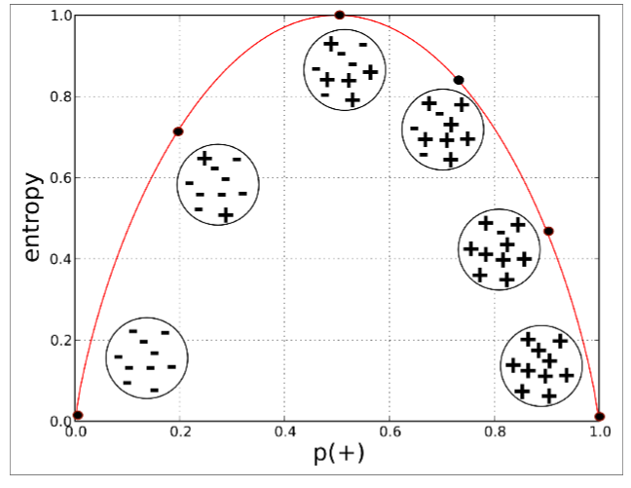
Entropy
Ten instances containing two classes : + and -
(Provost and Fawcett, 2013)

Slide 30

Choosing Attributes
Information gain:
  Expected reduction in entropy (high is good)
Entropy of whole example set T is E(T)
Examples with a=v, v is j^{th} value are T_{j,}
Entropy E(a=v_{j})=E(T_{j})
Gain is:
  T = total samples = 20
  T_{j} = number of samples with value j (Y/N values)

Slide 31
Information Gain Example
For root of tree, there are 20 examples:
  For c=2 (positive and negative) classification categories
  Probability of being positive with 11 examples
    p_{i=positive} = 11/20
  Probability of being negative with 9 examples
    p_{i=negative} = 9/20

Slide 32
Information Gain Example
For root of tree there are 20 examples:
  For c=2 (positive and negative) classification categories
  Entropy of all training examples E(T) is:
  |T| = 20
  E(T) = -11/20 x log₂ 11/20 - 9/20 x log₂ 9/20
  = 0.993

Slide 33
Entropy Example
  E(City/Town = Y) = 0.881 —> 7 (+) and 3 (-)
  E(City/Town = N) = 0.971 —> 4 (+) and 6 (-)
  Total sample for E(City/Town = Y) = 10
  Total sample for E(City/Town = N) = 10

Slide 34
Information Gain Example
City/Town as root node:
  10 examples for a=City/Town and value v=Y
    |T_{j=Y}| = 10 E(T_{j=Y}) = 0.881
  10 examples for a=City/Town and value v=N
    |T_{j=N}| = 10 E(T_{j=N}) = 0.971
  Gain(T, City/Town) = 0.993 – ((10/20 x 0.881) + (10/20 x 0.971))
  = 0.067

Slide 35
QUIZ
Calculate the information gain for the Transport attribute (10 minutes)
Use an A4 paper, put your name and your student ID

Slide 36
The attributes define whether
the example is a:
City or town: Yes or No
Has a university nearby: Yes or No
Type of nearby housing estate:
None, Small, Medium, Large
Quality of public transport:
Good, Average, Poor
The number of school nearby:
Small, Medium, or Large
E(T) = 0.993

Slide 37
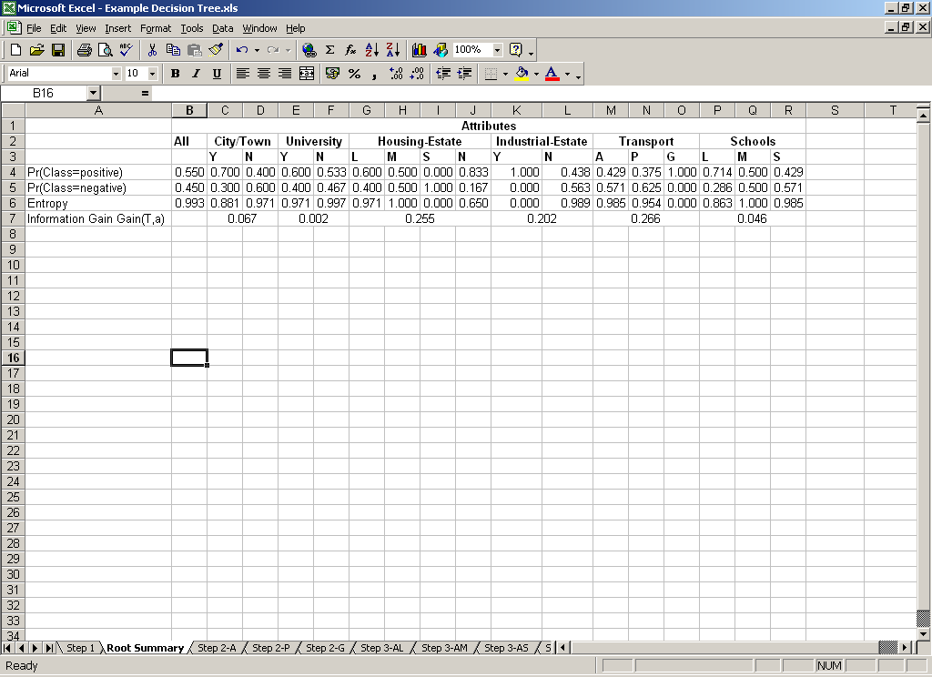
Information Gain Example

Slide 38
Choosing Attributes
Chose root node as the attribute that gives the highest Information Gain
  In this case attribute Transport with 0.266
Branches from root node then become the values associated with the attribute
  Recursive calculation of attributes/nodes
  Filter examples by attribute value

Slide 39
Recursive Example
With Transport as the root node:
  Select examples where Transport is Average
  (1, 3, 6, 8, 11, 15, 17)
  Use only these examples to construct this branch of the tree
  Repeat for each attribute (Poor, Good)

Slide 40
Transport is Average:
(1, 3, 6, 8, 11, 15, 17)
For Y:
2 positives, 2 negatives

Slide 41
Transport is Average:
(1, 3, 6, 8, 11, 15, 17)
For N:
1 positives, 2 negatives

Slide 42
Choosing child node
  Choice of attributes where Transport is Average {1, 3, 6, 8, 11, 15, 17}:
  City/Town, University, Housing Estate, Industrial Estate, and Schools (w/o Transport)
  City/Town: is either Y or N
  For Y: 2 pos examples {1,3}, 2 neg {8,15}
  For N: 1 pos {11}, 2 neg {6,17}
  Attribute a=City/Town that has value v=Y
  Prob of v=Y being positive p_{i=pos} = 2/4
  Prob of v=Y being negative p_{i=neg} = 2/4

Slide 43
Choosing child node
  E(T₁=City/Town=Y) = -2/4 log₂ 2/4 – 2/4 log₂ 2/4 = 1
  Attribute a=City/Town that has value v=N
  Prob of v=N being positive p_{i=pos} = 1/3
  Prob of v=N being negative p_{i=neg} = 2/3
  E(T₂=City/Town=N) = -1/3 log₂ 1/3 – 2/3 log₂ 2/3 = 0.918
  For all 7 examples {1, 3, 6, 8, 11, 15, 17}
  Prob of being pos p_{i=pos} = 3/7
  Prob of being pos p_{i=neg} = 4/7
  E(T)= -3/7 log₂ 3/7 – 4/7 log₂ 4/7 = -0.43 log0.43/log2 – 0.57 log0.57/log2 = 0.985
  Gain(T,City/Town) = E(T) – T₁/T * E(T₁) – T₂/T * E(T₂)
        = 0.985 – 4/7 * 1 – 3/7 * 0.918 = 0.020
        Y ⬅ 4 3 ➔ N

Slide 44
Final Tree
Transport
A
P
G
{1,3,6,8,11,15,17}
Housing Estate
{2,4,5,9,10,13,14,18}
Industrial Estate
{7,12,16,19,20}
Positive
L
M
S
N
Y
N
{11,17}
Industrial Estate
{1,3,15}
University
{8}
Negative
{6}
Negative
{5,9,14}
Positive
{2,4,10,13,18}
Negative
Y
N
Y
N
{11}
Positive
{17}
Negative
{1,3}
Positive
{15}
Negative
Callan 2003:243

Slide 45
ID3
Procedure Extend(Tree d, Examples T)
  Choose best attribute a for root of d
    Calculate E(a=v) and Gain(T,a) for each attribute
    Attribute with highest Gain(T,a) is selected as best
  Assign best attribute a to root of d
  For each value v of attribute a
    Create branch for v=a resulting in sub-tree d_{j}
    Assign to T_{j} training examples from T where v=a
    Recurse sub-tree with Extend(d_{j}, T_{j})

Slide 46
Data Issues
Use prior knowledge where available
Understand the data
  Examples may be noisy
  Examples may contain irrelevant attributes
  For missing data items, substitute appropriate values or remove examples
  Check the distribution of attributes across all examples and normalise where appropriate
Where possible, split the data
  Use a training, validation and test data set
  Helps to construct an appropriate system and test generalisation
  Validation data can be used to limit tree construction/prune the tree to achieve a desired level of performance

Slide 47
Extracting Rules
We can extract rules from decision trees
  Create one rule for each root-to-leaf path
  Simplify by combining rules
Other techniques are not so transparent:
  Neural networks are often described as ‘black boxes’ – it is difficult to understand what the network is doing
  Extraction of rules from trees can help us to understand the decision process

Slide 48
Rules Example
Transport
A
P
G
{1,3,6,8,11,15,17}
Housing Estate
{2,4,5,9,10,13,14,18}
Industrial Estate
{7,12,16,19,20}
Positive
L
M
S
N
Y
N
{11,17}
Industrial Estate
{1,3,15}
University
{8}
Negative
{6}
Negative
{5,9,14}
Positive
{2,4,10,13,18}
Negative
Y
N
Y
N
{11}
Positive
{17}
Negative
{1,3}
Positive
{15}
Negative
Callan 2003:243

Slide 49
Rules Example
IF Transport is Average
AND Housing Estate is Large
AND Industrial Estate is Yes
THEN Positive
…
IF Transport is Good
THEN Positive

Slide 50
Choosing machine learning algorithm for your problem
What are the benefits/drawbacks of machine learning?
  Are the techniques simple?
  Are they simple to implement?
  Are they computationally cheap?
  Do they learn from experience?
  Do they generalise well?
  Can we understand how knowledge is represented?
  Do they provide perfect solutions?

Slide 51
Real-life implementation of AI
Machines learning from experience…
  Through examples, analogy or discovery
  But real life is imprecise – how do you know which data is valid and collect (enough of) it?
Adapting…
  Changes in response to interaction
  But you only want to learn what’s ‘correct’ – how do you know this (you don’t know the solution)?
Generalising…
  To use experience to form a response to novel situations
  How do you know the solution is accurate?

Slide 52
Source Texts
Negnevitsky, M. (2005). Artificial Intelligence: A Guide to Intelligent Systems. 2nd Edition. Essex, UK: Pearson Education Limited.
  Chapter 6, pp. 165-168, chapter 9, pp. 349-360.
Callan, R. (2003). Artificial Intelligence, Basingstoke, UK: Palgrave MacMillan.
  Part 5, chapters 11-17, pp. 225-346.
Luger, G.F. (2002). Artificial Intelligence: Structures & Strategies for Complex Problem Solving. 4th Edition. London, UK: Addison-Wesley.
  Part IV, chapters 9-11, pp. 349-506.

Slide 53
Journals
Artificial Intelligence
  http://www.elsevier.com/locate/issn/00043702
  http://www.sciencedirect.com/science/journal/00043702

Slide 54
Articles
Quinlan, J.R. (1986). Induction of Decision Trees. Machine Learning, vol. 1, pp.81-106.
Quinlan, J.R. (1993). C4.5: Programs for Machine Learning. San Mateo, CA: Morgan Kaufmann Publishers.

Slide 55
Websites
UCI Machine Learning Repository
  Example data sets for benchmarking
  http://www.ics.uci.edu/~mlearn/MLRepository.html
Wonders of Math: Game of Life
  Game of life applet and details
  http://www.math.com/students/wonders/life/life.html

Slide 56
THANK YOU

